Slide 1
Android Services
Mobile Computing

Slide 2
Service, Thread and AsyncTask
Service is like an Activity but has no interface. Probably if you want to fetch the weather for example you won't create a blank activity for it, for this you will use a Service.
A Thread is a Thread, probably you already know it from other part. You need to know that you cannot update UI from a Thread. You need to use a Handler for this, but read further.
An AsyncTask is an intelligent Thread that is advised to be used. Intelligent as it can help with it's methods, and there are two methods that run on UI thread, which is good to update UI components.

Slide 3
When to use Services?
Use Service when you've got something that has to be running in the background for extended periods of time. It's not bound to any activity. The canonical example is a music player.

Slide 4
Difference between bound and unbound service
Bound Service :Service which call indefinitely in between activity
An Android component may bind itself to a Service using bindservice (). A bound service would run as long as the other application components are bound to it. As soon as they unbind, the service destroys itself.

Slide 5
Difference between bound and unbound service
Unbound Service :Service which call at the life span of calling activity
In this case, an application component starts the service, and it would continue to run in the background, even if the original component that initiated it is destroyed. For instance, when started, a service would continue to play music in the background indefinitely.

Slide 6
Life Cycle of Services
Services has different life cycle from Activity. Services has different method for their life cycle.

Slide 7
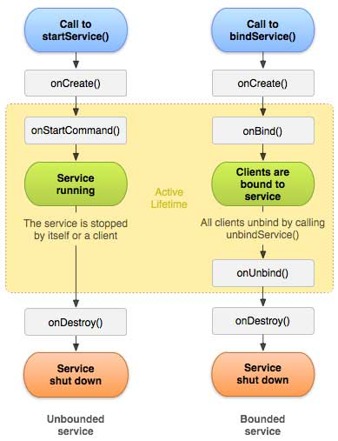

Slide 8
When onCreate is called?
The first method onCreate is called only one time when the Service has to created. If the Service is already running this method won’t be called. We don’t call it directly but it is the OS that calls it.

Slide 9
When onStartCommand is called?
OnStartCommand is the most important method because it is called when we required to start the Service. In this method we have the Intent passed at time we run the Service, in this way we can exchange some information with the Service. In this method, we implement our logic that can be execute directly inside this method if it isn’t time expensive otherwise we can create a thread. As you can see this method requires we return an Integer as result. This integer represents how the Service should be handled by the OS:
START_STICKY : Using this return value, if the OS kills our Service it will recreate it but the Intent that was sent to the Service isn’t redelivered. In this way the Service is always running
START_NOT_STICKY: If the SO kills the Service it won’t recreate it until the client calls explicitly onStart command
START_REDELIVER_INTENT: It is similar to the START_STICKY and in this case the Intent will be redelivered to the service

Slide 10
When onDestroy is called?
OnDestroy is the method called by the OS when the Service will be destroyed.

Slide 11
Create a Service
In Android to create a Service we have to extend Service class.
public class TestService extends Service { @Override
public IBinder onBind(Intent arg0) {
return null;
}
}
Note: we have to implement only one method called onBind. In our case, we are using local service, so this method should return null.

Slide 12
Override Callback Methods
public class TestService extends Service {
@Override
public void onCreate() {
super.onCreate();
}
@Override
public void onDestroy() {
super.onDestroy();
}
@Override
public int onStartCommand(Intent intent, int flags, int startId){
return super.onStartCommand(intent, flags, startId);
}
@Override
public IBinder onBind(Intent arg0) {
return null;
}
}

Slide 13
Declare Service Class in Manifest
<service android:name=".TestService" android:enabled="true"/>

Slide 14
Start Service
A Service in Android can be started from an Activity, from a Broadcast receiver and other services too.
Intent i = new Intent(MainActivity.this,TestService.class); i.putExtra("name", "SurvivingwithAndroid"); MainActivity.this.startService(i);

Slide 15
Stop Service
Intent i = new Intent(MainActivity.this, TestService.class); MainActivity.this.stopService

Slide 16
Create Thread in onStartCommand
A service runs on the main thread, so we have to be very careful when we implement some logic in this service. We have to consider that if this logic is a blocking operation or it requires long time to finish a ANR problem could occur. In this case we have to move our logic to a separate thread, meaning we have to create a thread in onStartCommand method and run it.

Slide 17
IntentService
There is another class called IntentService derived from Service that simplify our life. This class is useful when we don’t need to handle multiple requests at the same time. This class creates a worker thread to handle different requests. This class performs this operation:
create a separate thread to handle the request
create a request queue and pass one Intent at time
create a default implementation of onStartCommand
stop the service when all the requests are processed

Slide 18
Create IntentService
public class TestIntentService extends IntentService {
public TestIntentService() { super("TestIntentService");
}
@Override
protected void onHandleIntent(Intent intent){
}
}
Note: In this case we have only one method to implement called onHandleIntent. Here we implement out logic without caring if this is operation requires long time or not, because this method is called in a separate thread.

Slide 19
Starting service automatically
Many times we want to start our service automatically, for example at boot time. We know to start a Service we need a component to start it. How can we do it? Well, we could use a Broadcast receiver that starts our service. If for example we want to start it at the smartphone boot time, we create first a Broadcast receiver that listens to this event and then it starts the service.
public class BootBroadcast extends BroadcastReceiver { @Override
public void onReceive(Context ctx, Intent intent) { ctx.startService(new Intent(ctx, TestService.class));
}
}

Slide 20
Manifest.xml
<receiver android:name=".BootBroadcast"> <intent-filter >
<action android:name="android.intent.action.BOO T_COMPLETED"/>
</intent-filter>
</receiver>

